Slide 1



Analytics consulting project

Slide 2



Slide 3



Slide 4
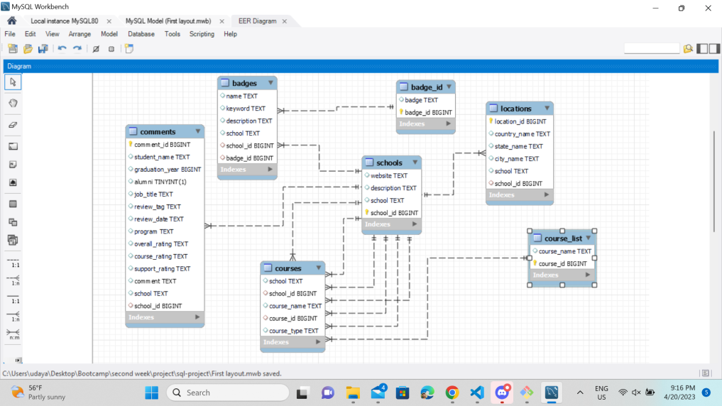

Slide 5
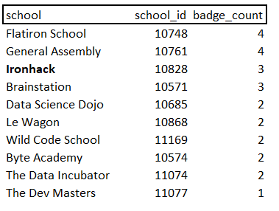
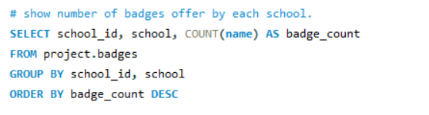
QUERY 1
Number of badges
We can see according to this query that Ironhack
offers and above-average number of services

Slide 6
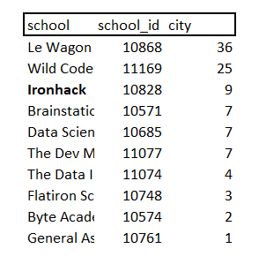
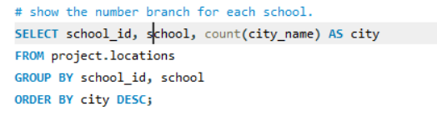
QUERY 2
Number of
campuses
We can see from this result that the values of number of badges and number
of campuses don’t align and therefore we keep deep diving looking for answers

Slide 7
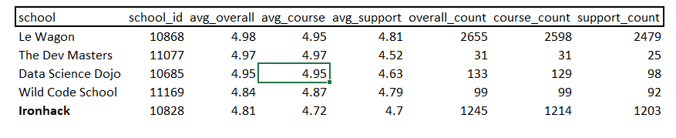
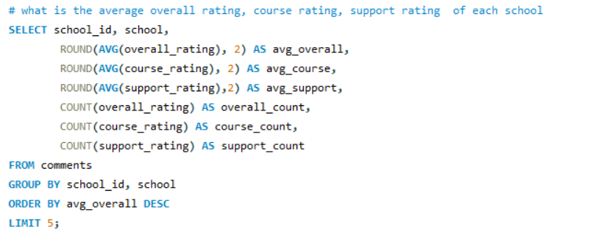
QUERY 3
Average rating
We can see according to this query that Ironhack has
the lowest overall rating between the top 5, why? Let’s keep deep diving

Slide 8
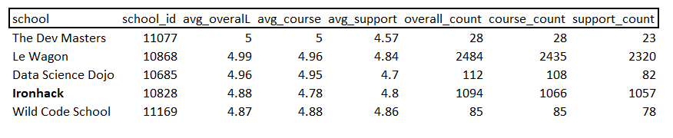
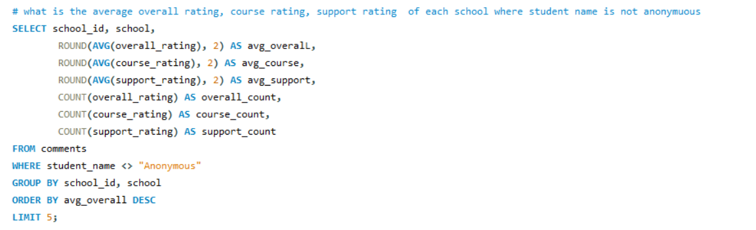
QUERY 4
Anonymous ratings omitted
With this query we’re filtering out the reviews published
by anonymous, since they’re less relevant or could be fake reviews

Slide 9
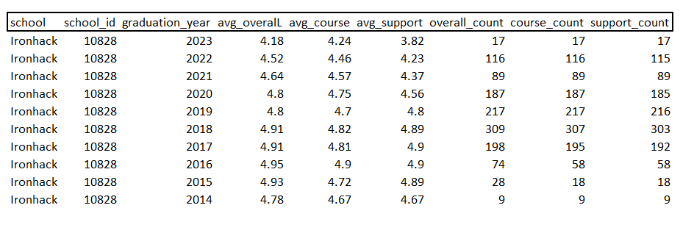
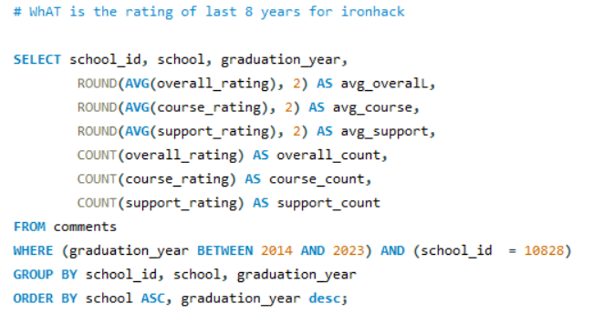
QUERY 5
Yearly rating Ironhack

Slide 10
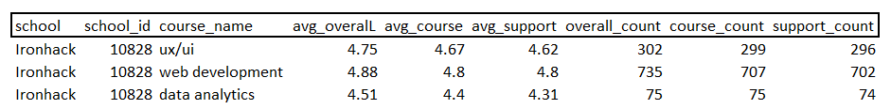
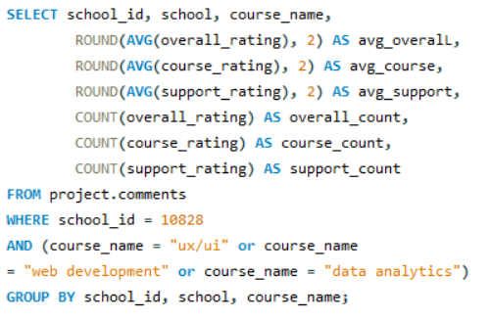
QUERY 6
Rating according
to course
And here we can see the different ratings for every course
so we can identify if the rating problem lies in one of them

Slide 11
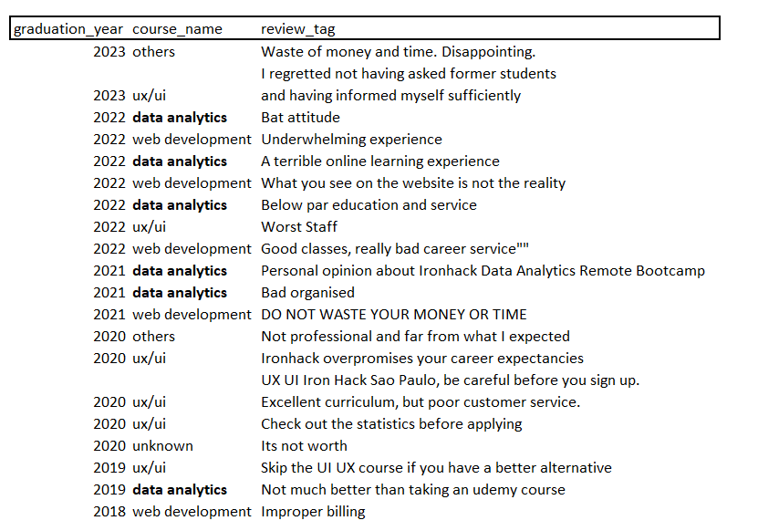
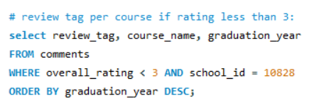
QUERY 7
Comments title
And here we can see the reasons for the low rates,
and therefore the problems that can be fixed

Slide 12
